Slide 1
CS 1B Review Part 2

Slide 2

Topics
Structured Programming vs. Object-Oriented Programming
Using Inheritance to Create a New C++ class Type
Using Composition (Containment) to Create a New C++ class Type
Static vs. Dynamic Binding of Operations to Objects

Slide 3
Two Programming Paradigms
Structural (Procedural) Object-Oriented
PROGRAM PROGRAM (OOP)
FUNCTION
OBJECT
Operations
Data
FUNCTION
OBJECT
OBJECT
Operations
Data
FUNCTION
Operations
Data

Slide 4
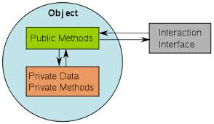
OOP vs. Structured Programming
In OOP an object is a fundamental entity, while in structured programming a function is a fundamental entity
In OOP objects are debugged, while in structured programming functions are debugged
In structured programming a program is a collection of interacting functions, while in OOP a program is a collection of interacting objects
In structured programming the programmer is action oriented, while in OOP the programmer is object oriented
The object-oriented programming (OOP) implements Object Oriented Design (OOD)

Slide 5
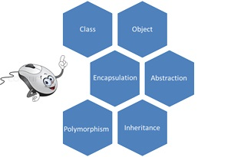
The Fundamentals of Object Oriented Design (OOD)
Encapsulation
Combine data and operations on data in a single unit.
Inheritance
Create new objects from existing objects
Polymorphism
The ability to use the same expression to denote different operations

Slide 6
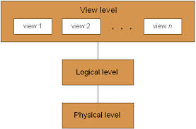
Object-Oriented Programming Language Features
1. Data abstraction
- Separates the logical properties of a data type from its implementation
2. Inheritance of properties
3. Dynamic binding of operations to objects

Slide 7
Terms

Slide 8
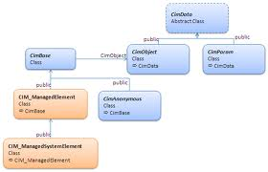
Relationship between C++ classes
C++ classes can be related to each other in various ways
The three most common ways
Two classes are independent (nothing in common)
Two classes are related by inheritance
Two classes are related by composition

Slide 9
Inheritance
Is a mechanism by which one class acquires (inherits) the properties (both data and operations) of another class
The class being inherited from is called the base, parent or superclass
The class that inherits is called the derived, child, or subclass
The derived class is then “specialized” by adding properties specific to it
Inheritance can be viewed as a tree-like, or hierarchical, structure wherein a base class is shown with its derived classes

Slide 10
Why Inheritance?
Inheritance is a facility that allows one to adapt code from other classes
Suppose a new class is needed and a class already exists that represents part of what is needed
However it does not provide all needed services (functions)
A new class can be created or derived from an existing class
The derived class inherits all the services provided by the existing class
Additional services can be added

Slide 11
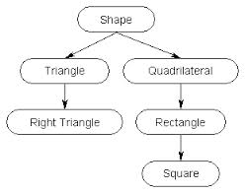
Inheritance Example

Slide 12

Inheritance Hierarchy Among Vehicles
vehicle
wheeled vehicle
boat
car
bicycle
two-door
four-door
Every car is a wheeled vehicle

Slide 13

“is a” Relationship
The inheritance relationship can be viewed as a “is a” relationship
For example
Every car “is a” vehicle (a car inherits properties of a vehicle)
Every two door car “is a” car (a two-door car inherits properties of a car)

Slide 14
Vehicle Inheritance
class vehicle {/* . . . */};
class wheeledVehicle : public vehicle { /* . . . */};
class boat : public vehicle { /* . . . */};
class car : public wheeledVehicle {/* . . . */ };
class bicycle : public wheeledVehicle {/* . . . */ };
class two-door : public car {/* . . .*/};
class four-door : public car {/* . . .*/};

Slide 15
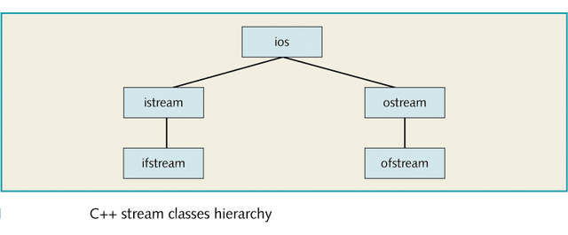
C++ Stream Classes

Slide 16
ios class
The class ios is the base class for all stream classes
Classes istream and ostream are directly derived from the class ios
The class ifstream is derived from the class istream, and the class ofstream is derived from the class ostream
The class ios contains formatting flags and member functions to access and/or modify the setting of these flags
To identify the I/O status, the class ios contains an integer status word
This integer status word provides a continuous update reporting the status of the stream
The classes istream and ostream are responsible for providing the operations for the data transfer between memory and devices

Slide 17
ios Derived Classes
The class istream defines the extraction operator, >>, and functions such as get and ignore
The class ostream defines the insertion operator, <<, which is used by the object cout
The class ifstream is derived from the class istream to provide the file input operations
The class ofstream is derived from the class ostream to provide the file output operations
Objects of the type ifstream are used for file output; objects of the type ofstream are used for file output
The header file fstream contains the definition of the classes ifstream and ofstream

Slide 18


Inheritance Allows One to Reuse Code
A “child” or derived class inherits members from one or more base or “parent” classes
Inherited members literally become part of the derived class without having to be rewritten or copied

Slide 19
Inheritance Allows for Adaptation of Code
Inheritance allows one to create specialized classes that add to or modify the basic concept or behavior of a more generalized class
For example: A square is a special type of rectangle
The derived (child) class inherits all the properties of the base (parent) class (except for the private members)
The data and operations defined in the base class are also defined in the derived class
Specific properties are added to the derived class to make it unique
Inheritance allows the creation of extensible data abstractions
The derived classes extends the base class by adding private data and public operations

Slide 20
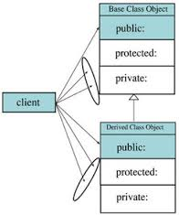
Access Specifiers (Expanded View)
public: (public interface)
Provides the interface between the client code and the class objects
Are accessible by both client code and derived classes
Function members (methods) are generally declared public
private: (members are inaccessible to clients)
Not accessible by any client nor are they accessible by derived classes
Default
Data members are generally declare private
protected:
Not accessible by client code but are accessible by derived classes

Slide 21
Access Method for Inheritance - 1
Public Inheritance
public members of the base class become public members of the derived class and protected members of the base class become protected members of the derived class
A base class's private members are never accessible directly from a derived class, but can be accessed through calls to the public and protected members of the base class

Slide 22
Access Method for Inheritance - 2
Protected Inheritance
public and protected members of the base class become protected members of the derived class
Private Inheritance
public and protected members of the base class become private members of the derived class

Slide 23
Base Initialization list
Data members can be initialized in a constructor using a “base initialization list”
Data members are initialized after the parenthesis that ends the parameter list
On the function definition statement after a :
Not within the body of the function
The invocation of a base class constructor within a child class constructor requires this syntax

Slide 24
Using a Base Initialization list
class Time
{
public :
Time ( int initHrs, int initMins, int initSecs ) ;
Time ( ) ;
private :
int hrs ;
int mins ;
int secs ;
} ;
Time :: Time ( ) : hrs(0), mins(0), secs(0)
{ // empty body
}
Time :: Time (int initHrs, int initMins, int initSecs ):
hrs (initHrs),
mins (initMins),
secs (initSecs)
{ // empty body }

Slide 25

Time Specification
class Time
{
public :
void Set ( int hours , int minutes , int seconds ) ;
void Increment ( ) ;
void Write ( ) const ;
Time ( int initHrs, int initMins, int initSecs ) ;
Time ( ) ;
private :
int hrs ;
int mins ;
int secs ;
} ;

Slide 26
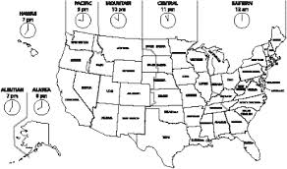
Adding a data member
Desire: Add time zone member
Ways to accomplish this
Change the time class specification and implementation files
Not always possible since source code is sometimes proprietary
This method would also violate the encapsulation paradigm
Use inheritance principal
Create a new class, called ExtTime, that inherits the properties of the time class

Slide 27
The General Syntax of a Derived Class
class className: memberAccessSpecifier baseClassName
{
member list
};
where memberAccessSpecifier is public, protected, or private
When no memberAccessSpecifier is specified, it is assumed to be a private inheritance
Example specifying inheritance
class ExtTime : public Time // Time is a public base class

Slide 28

memberAccessSpecifier
public
All the public members of the base class (except for the constructors) are also public members of child class
Clients can invoke the public members (except for the constructors) of the base class for the derived class objects
private
Public members of the base class are not public members of the derived class
Clients of the derived class cannot invoke the base class methods on the derived class objects
A derived class cannot access the private members of its base class
Would violate the encapsulation paradigm
All data members of the base class are also data members of the derived class
Similarly, the member functions of the base class (unless redefined) are also the member functions of the derived class

Slide 29

Steps Needed to Create a Child Class
Procedure to create a child class
Add new data member(s)
Write new constructor(s) (required)
Add or overwrite member functions if necessary
Constructor rules for derived classes
At run time, the base class constructor is implicitly called first, before the body of the derived class’s constructor executes
If the base class constructor requires parameters, they must be passed by the derived class’s constructor

Slide 30
Inherit the ExtTime Class from the Time Class
For the ExtTime class
New data member zone is added
Member functions Set and Write are overridden
The increment function for the Time class can be invoked for ExtTime class objects (not overridden)
The private members of ExtTime are hrs, mins, secs, (inherited from Time), and zone
Note: every ExtTime object is a Time object
Time is the base class and ExtTime is the derived class

Slide 31

ExtTime Specification
enum ZoneType {EST, CST, MST, PST, EDT, CDT, MDT, PDT } ;
class ExtTime : public Time
{
public :
void Set ( int hours, int minutes, int seconds ,
ZoneType timeZone ) ;
void Write ( ) const ;
ExtTime ( int initHrs , int initMins , int initSecs ,
ZoneType initZone ) ;
ExtTime ( ) ;
private :
ZoneType zone ; // added data member
} ;

Slide 32
ExtTime Constructors
ExtTime :: ExtTime ( ) : Time( )
{
zone = EST ;
}
//*************************************************************
ExtTime :: ExtTime(int initHrs,
int initMins,
int initSecs,
ZoneType initZone )
: Time (initHrs, initMins, initSecs)
{
zone = initZone ;
}

Slide 33
Instantiating ExtTime objects
ExtTime thisTime(8,35,0,PST) ;
The first three parameters are passed to the Time constructor before zone is set in the ExtTime constructor
ExtTime thatTime ;
The default constructor of the Time class is called before the zone is set to EST

Slide 34
ExtTime Set function
void ExtTime :: Set (int hours,
int minutes,
int seconds,
ZoneType timeZone )
{
Time :: Set (hours, minutes, seconds); // calls base function
zone = timeZone ;
}
There are two distinct Set( ) functions
Time::Set(...) and ExtTime::Set(...)
The ExtTime::Set() calls the Time::Set() to set the hrs, mins, secs
It cannot set hrs, mins, and secs since they are private members of the Time class
The ExtTime::Set( ) sets the zone

Slide 35
Redefinition of Member Functions
To redefine a member function, the redefinition must have
Same name
Same signature as the function it replaces
Otherwise there are two distinct functions
Original function (which is inherited)
The new function with a different signature
(See example inherit1.cpp)

Slide 36

Avoiding Multiple Inclusion of Header Files
Often several program files use the same header file containing typedef statements, constants, or class type declarations--but, it is a compile-time error to define the same identifier twice
This preprocessor directive syntax is used to avoid the compilation error that would otherwise occur from multiple uses of #include for the same header file
#ifndef Preprocessor_Identifier
#define Preprocessor_Identifier
.
.
.
#endif
(See example inherit2.cpp)

Slide 37
Composition (or Containment)
Is a mechanism by which the internal data (the state) of one class includes an object of another class
One object is contained within a class
There is no special syntax
An object is declared to be one of the data members of another class
Like a struct within a struct
Composition is a “has a” relationship
For example, a Timecard object “has a” Time object

Slide 38
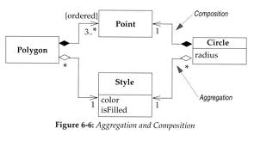
TimeCard Class
A typical timecard class would need
Employee id
Time the employees “punches in or punches out”
The TimeCard class can use the Time class

Slide 39

TimeCard Specification
class TimeCard
{
public:
void Punch (int hours, int minutes, int seconds ) ;
void Print ( ) const ;
TimeCard (long idNum, int initHrs, int initMins, int initSecs ) ;
TimeCard ( ) ;
private:
long id ;
Time timeStamp ;
} ;

Slide 40
TimeCard Constructors
TimeCard :: TimeCard( )
{
id = 0 ;
}
//***********************************************************
TimeCard :: TimeCard (long idNum, int initHrs, int initMins, int initSecs ): timeStamp (initHrs, initMins, initSecs)
{
id = idNum ;
}

Slide 41
Difference between Inheritance and Composition Constructors
When using inheritance
ExtTime :: ExtTime(int initHrs, int initMins, int initSecs, ZoneType initZone ) : Time (initHrs, initMins, initSecs) // base class specified
When using composition
TimeCard :: TimeCard (long idNum, int initHrs, int initMins, int initSecs : timeStamp (initHrs, initMins, initSecs) // member object specified

Slide 42

TimeCard Print Function
void TimeCard :: Print() const
{
cout << "ID: "<< id << " Time: " ; timeStamp.Write();
}
The timecard object can manipulate “id” via its member functions
It must use the Time card member functions to access private members of the Time class
The Print() and Punch() functions both invoke methods from the Time class
Otherwise the encapsulation paradigm would be violated
See examples comp1.cpp and comp2.cpp

Slide 43
Multiple Member Objects
When a class has several members that are objects of other classes
Constructors with parameters must specify the parameters for each base class
TimeCard :: TimeCard (long idNum, int initHrs, int initMins, int initSecs )
: timeStamp (initHrs, initMins, initSecs), anotherTimeStamp (initHrs, initMins, initSecs)
Member objects don’t have to be from the same base class

Slide 44
Order in Which Constructors are Executed
Given a class A
If A is a derived class its base class constructor is executed first
Finally, the body of A’s constructor is executed
Given Class A has a class member that is an object of class B
Class B's constructor is executed before Class A's
NewExtTime :: NewExtTime (int initHrs, int initMins,int initSecs, ZoneType initZone ) : Time (initHrs, initMins, initSecs), timeStamp (initHrs, initMins, initSecs) // Time is a base class and timeStamp is a member object

Slide 45
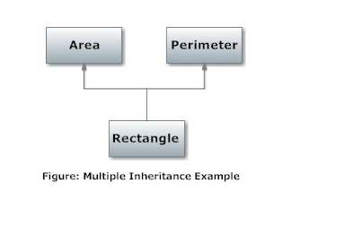
Multiple Inheritance
C++ support multiple inheritance
(see examples: multiple inheritance1 and 2)

